Slide 1

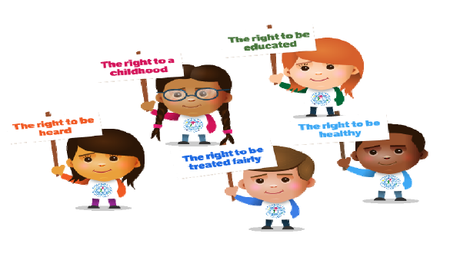
Upper Nidderdale
Primary Federation
Pupil Safeguarding Policy
September 2026

Slide 2
This is a Safeguarding Policy, but what does Safeguarding actually mean?
Safeguarding means that school staff should:
Protect you from harm (physical or emotional);
Make sure nothing stops you from being healthy or developing properly;
Make sure you are safely looked after;
Make sure you have the best life chances and can grow up happy and successful
This fits really well with our
Rights Respecting School ethos.

Slide 3
Our whole school attitude towards keeping you safe is based
around the UN Convention on the Rights of the Child.
Article 3
The best interests of the child must be a top priority in all
things that affect the child.
Article 12
Every child has the right to have a say in all matters
affecting them, and to have their views taken seriously.
Article 19
All children have the right to be protected from all forms of
violence, abuse, neglect, and bad treatment by their parents
or anyone else who looks after them.
Article 24
Every child has the right to the best possible health.
Article 27
Every child has a right to a standard of living that is good
enough to meet their physical, social and mental needs.
Your rights matter because YOU matter

Slide 4
What do we do at school to keep you safe?
All of the governors and staff in school work together to keep you safe.
Anybody who works at our school will be checked by something called the DBS. This is to make sure that they are safe to work with children.
Our school has DSLs (Designated Safeguarding Leads) to keep up to date with safeguarding information.
Our school has a safe system to get into school and locks on the external doors.
We have class registers to ensure that we can account for everyone.
We regularly do fire drills and lockdown drills so that everyone knows what to do in case of an emergency.
We do regular work in school for National Children’s Mental Health Week or for Anti-Bullying Week so that you are aware of your rights and what to do if you have a problem.
We have our Growth Mindset characters that help us to keep physically and mentally healthy.
Our weekly PSHE lessons include, healthy eating, anti-bullying, e-safety, road safety, how to report abuse/concerns if we are worried about our safety.
We have our ‘Fortnightly Focus’ quizzes to improve our safeguarding knowledge.

Slide 5
Feeling Safe
When we feel safe (physically and mentally), we usually feel good about ourselves and we can relax and enjoy life.
As a school, we provide a safe environment for you to learn in.
We want to help to ensure that you remain safe at home as well as at school.
It is really important that you know were to go to get help if you are worried or unhappy about anything.
You can always talk to a trusted adult.
Who is your trusted adult?
A trusted adult is a grown up that you feel comfortable talking about your worries to. Someone that you know will try to help and to make things better for you.
Everyone will have someone different that they feel is their trusted adult, but it could be;
A parent or grandparent
An older sibling
A grown up at school

Slide 6
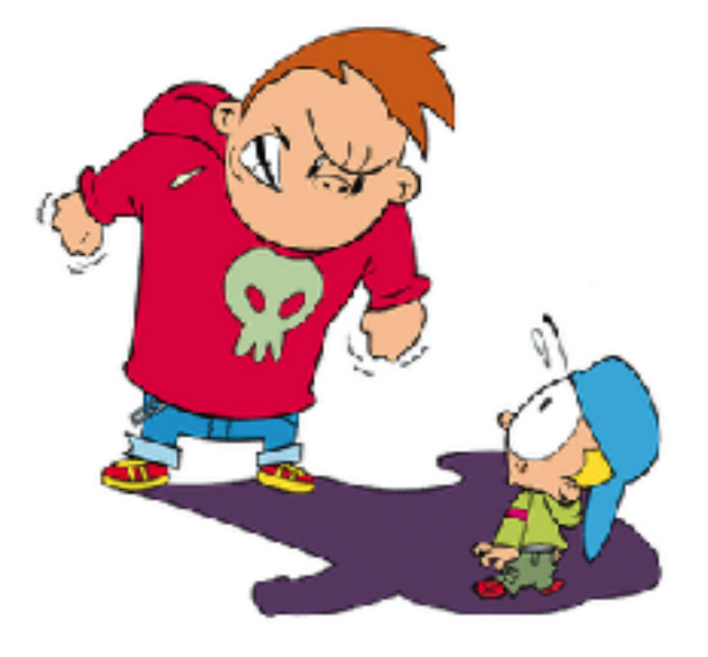
What to do if you are being bullied
If you feel like you are being bullied, you MUST tell a grown up. Even if the bully tells you that you must not tell anyone.
Sometimes even people that we think of as friends can treat us in an unkind way, even bully us. If we like them, then we may feel uncomfortable about telling an adult. However, if something does not feel right, always talk it over with your trusted adult. Do not bottle it up.
Do NOT keep it a
Secret!

Slide 7
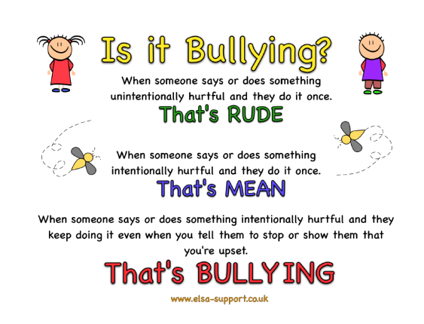
Ask yourself …..

Slide 8

What to do if someone says unkind things about you
Has someone said something to you or have you heard something that you do not like or upsets you?
You must tell someone at the school so we can help you.
Examples of people you can tell are:
Your Teacher
Miss Thornber, Mrs Wilkinson or Mrs. Fearnley
A friend
A trusted adult at home or at school

Slide 9
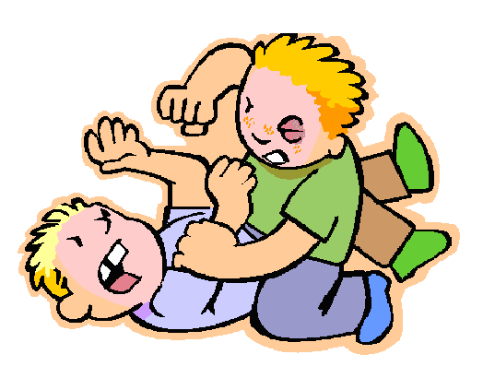

What to do if someone is hitting, punching or smacking you.
Has someone hit, punched or smacked you or hurt you
in any way?
You must tell someone at the school so we can help you. Remember, you have the right to be protected from harm and kept safe.
If in doubt, talk to someone. There are many staff at school for you to talk to and they will help support you.

Slide 10

How to look after your own wellbeing
It is really important that you know about how to look after your mental and emotional health as well as your physical health.
Your mental and emotional health is sometimes called your wellbeing.
There are some ways that you can help to look after your emotional health, such as:
STOP – here you ask yourself “how am I feeling?” - happy, scared, angry or sad. How you feel can make a difference to the choice you make.
2) THINK – here ask yourself “what are my options?” – think about all the different choices you can make; some will have good consequences and some will have less good consequences. (consequence means what may happen – if you stroke a cat the consequence may be that it purrs, if you give someone a compliment the consequence may be that they smile)
3) GO – once you’ve thought through the positive and negative consequences of each of your options you can make your choice.

Slide 11
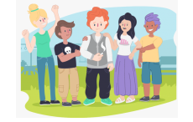
Peer Pressure
So what does peer pressure mean?
This is when someone your age (a peer) pressurises you (pushes you) to do something – that may make you feel ok about it, but it also may not.
Our friends and the people around us at school influence us – sometimes positively and sometimes negatively.
So the question is how to deal with peer pressure and remain cool as a cucumber?
1) Stop – how are you feeling? Do you feel safe, comfortable, certain about the request?
2) Think – what are your options? what are the consequences of these options?
3) Go – make the choice which makes you feel safest, happiest and calmest.

Slide 12
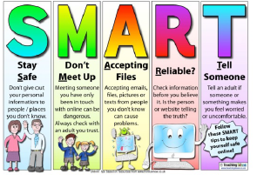
What to do to stay safe online
It is really important that you know about how to keep safe online as well. In school we do lots of lessons about keeping safe online .
Here are our Top Ten Tips for staying safe online:
1) Don’t post any personal information online – like your address, email address or mobile number.
2) Think carefully before posting pictures or videos of yourself. Once you’ve put a picture of yourself online most people can see it and may be able to download it, it’s not just yours anymore.
3) Keep your privacy settings as high as possible.
4) Never give out your passwords.
5) Don’t befriend people you don’t know.
6) Don’t meet up with people you’ve met online. Speak to your parent or carer about people suggesting you do.
7) Remember that not everyone online is who they say they are.
8) Think carefully about what you say before you post something online.
9) Respect other people’s views, even if you don’t agree with someone else’s views, doesn’t mean you need to be rude.
10) If you see something online that makes you feel uncomfortable, unsafe or worried: leave the website, turn off your computer if you want to and tell a trusted adult immediately

Slide 13
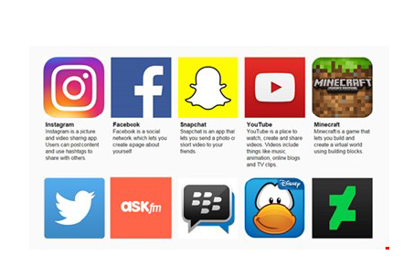
What to do to stay safe online
Think carefully about the sites that you use. Are they really appropriate for your age? If you are unsure. Talk to someone at home or at school.
Take the quiz on our school website to find out the suggested age restrictions on these sites.
To keep you safe online at school, we have filtering systems so that we can keep harmful content away from our computers. We have monitoring systems so that we know if anyone has been looking up inappropriate content.
Remember – If you ever feel unsafe, talk to someone.

Slide 14

AI (Artificial Intelligence)
There are lots of benefit to using AI, but it is important to remember that not all AI images, videos etc are true.
AI technology is capable of simulating the voice of a person, as well as creating images from ideas, This means it’s important that you do not trust everything that you see or watch online. Or, perhaps more importantly, every message that you get on social media.
Deepfakes are a videos, image, etc. in which a person’s face, body, or voice has been digitally altered so that they appear to be someone else, typically used maliciously or to spread false information:

Slide 15

Keeping Secrets
Remember that some secrets can be good and some are not. Secrets such as surprise parties are fun, but some secrets are not good and should never be kept. If someone asks you to keep a secret that you’re not comfortable with, talk to an adult that you trust.
It is important to remember that your body belongs to you and not to anyone else. This means all of your body. If someone touches you on a part of your body and you do not like, it is not ok.
You must tell your parents/carers, a teacher or someone you can trust as soon as you can.

Slide 16
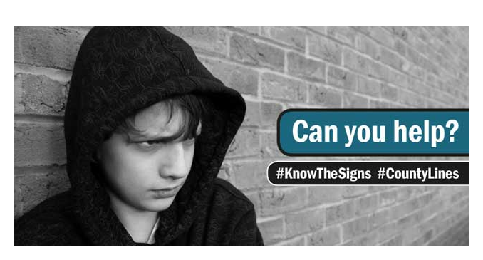
What to do if someone tries to give you drugs, cigarettes, tablets or alcohol.
Has someone asked you if you want a tablet or to smoke a cigarette, or have a drink of something and you do not know what it is?
If this ever happens, do not eat, drink or smoke what they are giving you.
You must tell a grown up straight away so that they can help you. DO NOT give into pressure if someone tries to persuade you or dares you to do something that you know is not safe.
Be aware that you could be offered any of these things by someone who is only a bit older than you. They might even try to get you to take the drugs to someone else for them. The police are aware of this problem and call it ‘County Lines.’
Talk to adult straight away if you are worried.

Slide 17

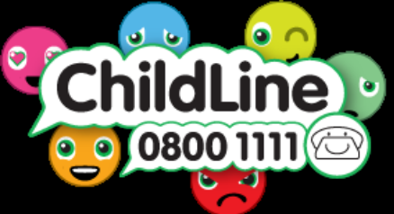



Organisations that can help you
The most important thing to remember is
that if you feel uncomfortable about ANYTHING at all:

